Slide 1
DDS Project 2
Employee Attrition and Salary Analysis
- Rohit Channe

Slide 2
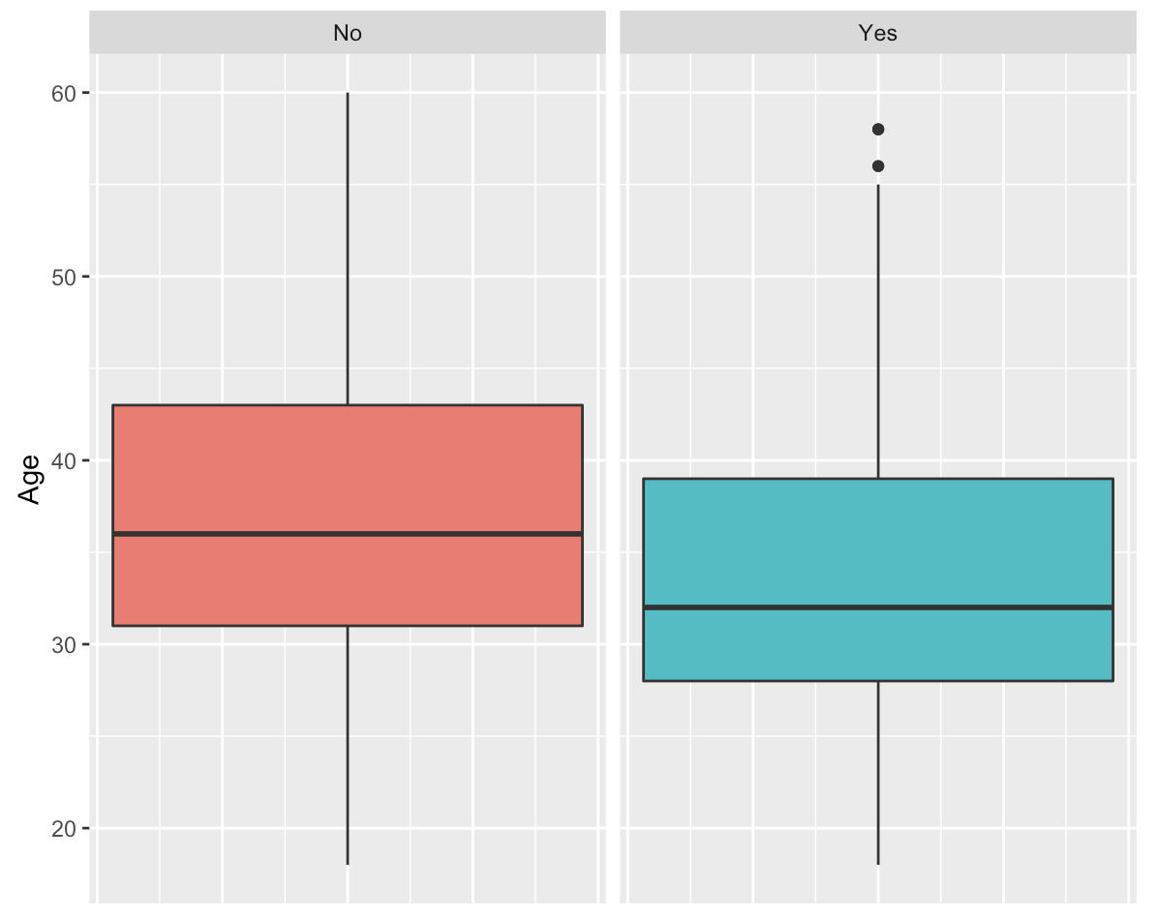
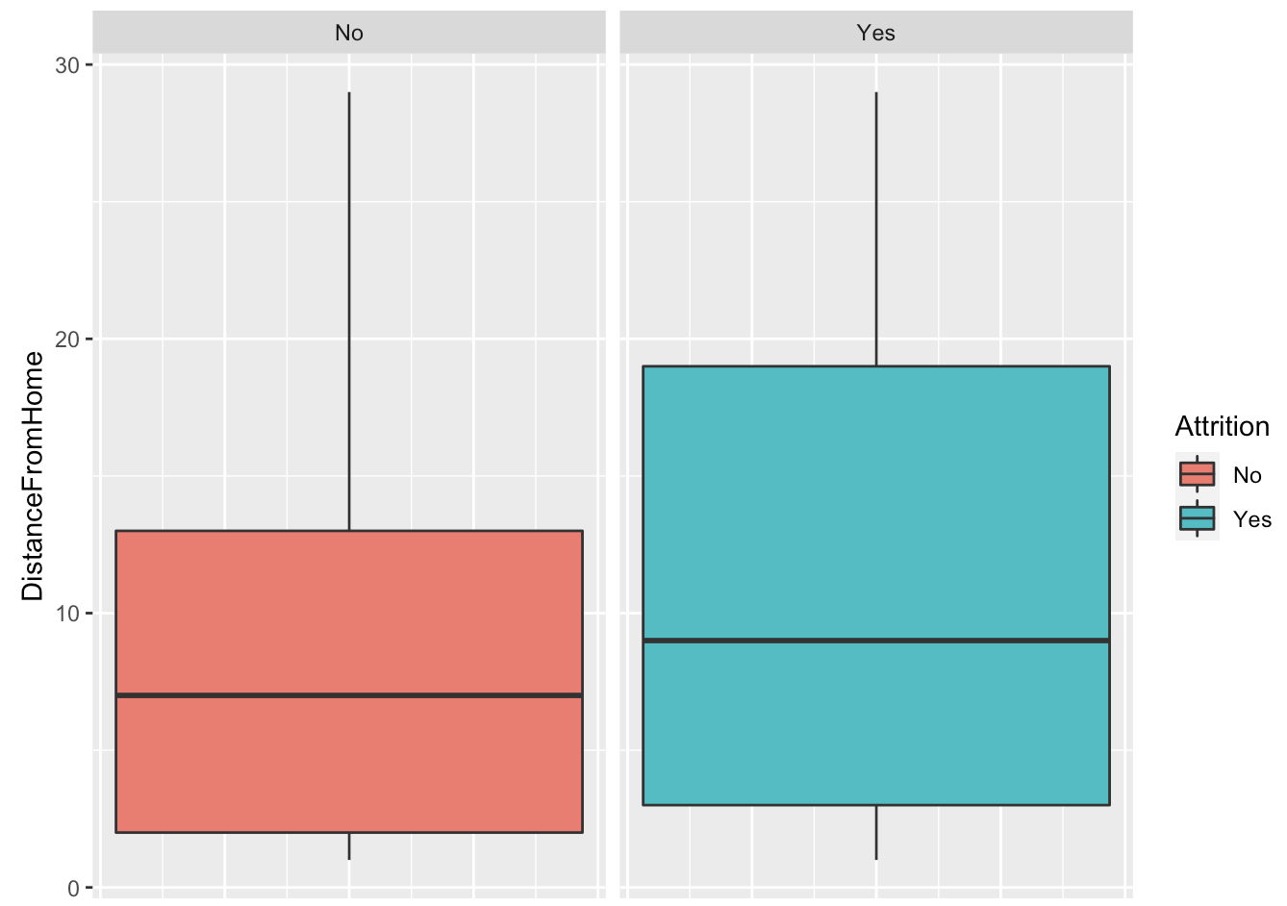
Analysing Important Factors for Employee Attrition

Slide 3
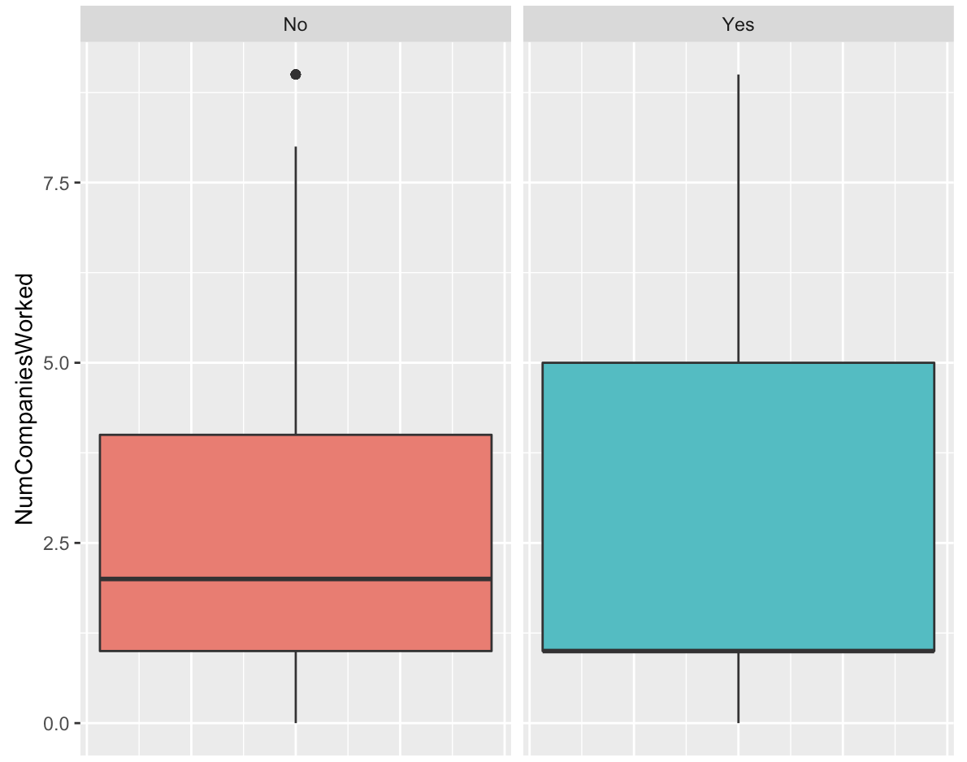
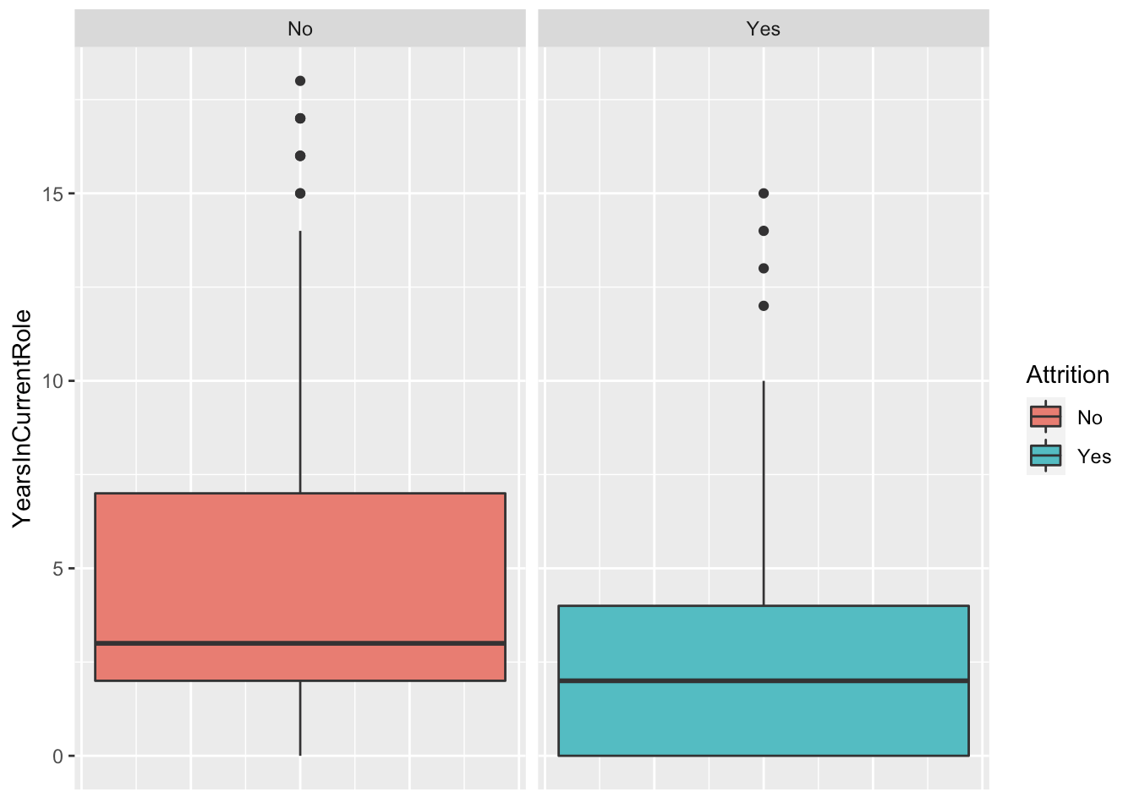
Analysing Important Factors for Employee Attrition Part 2

Slide 4
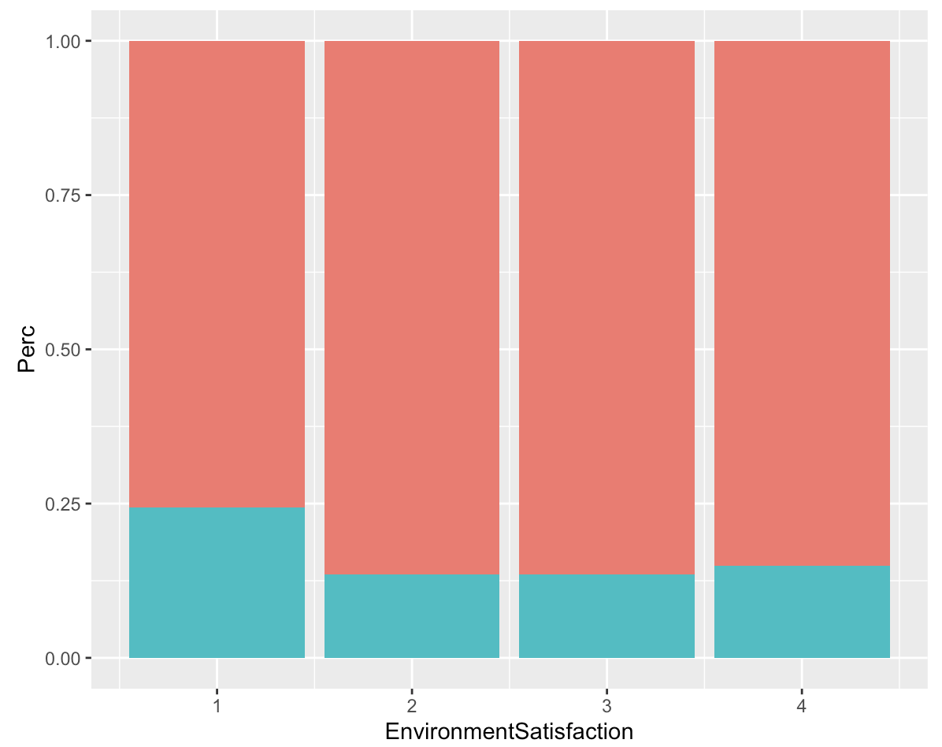
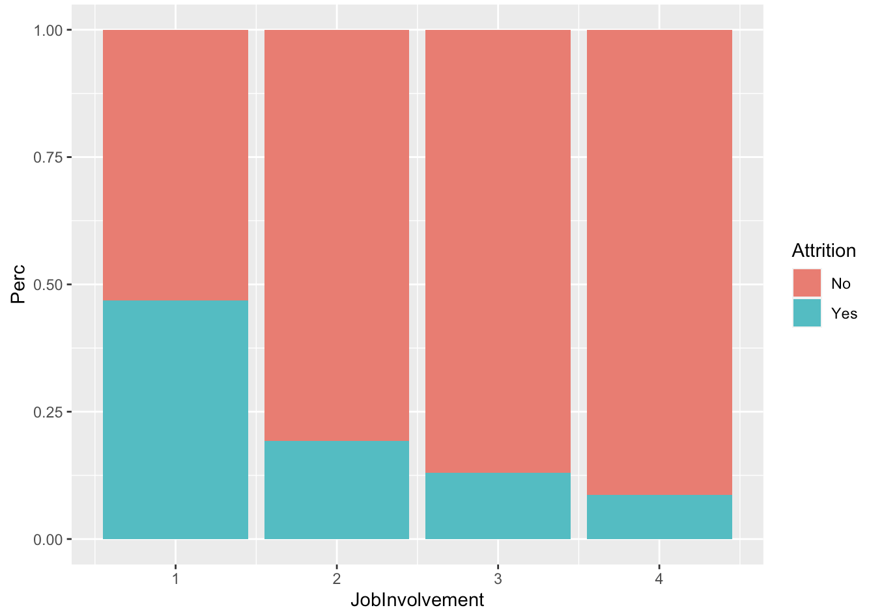
Analysing Important Factors for Employee Attrition Part 3

Slide 5
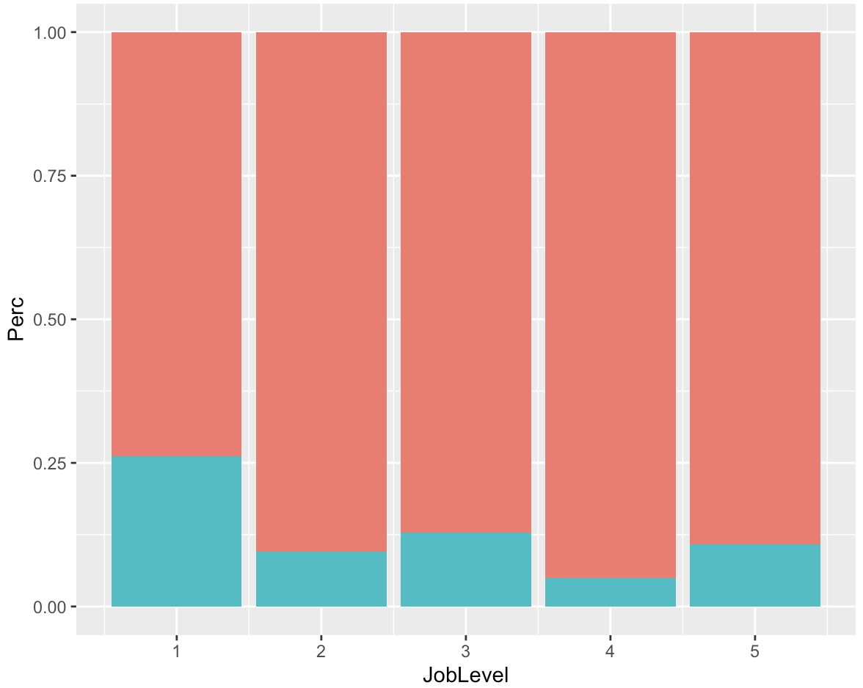
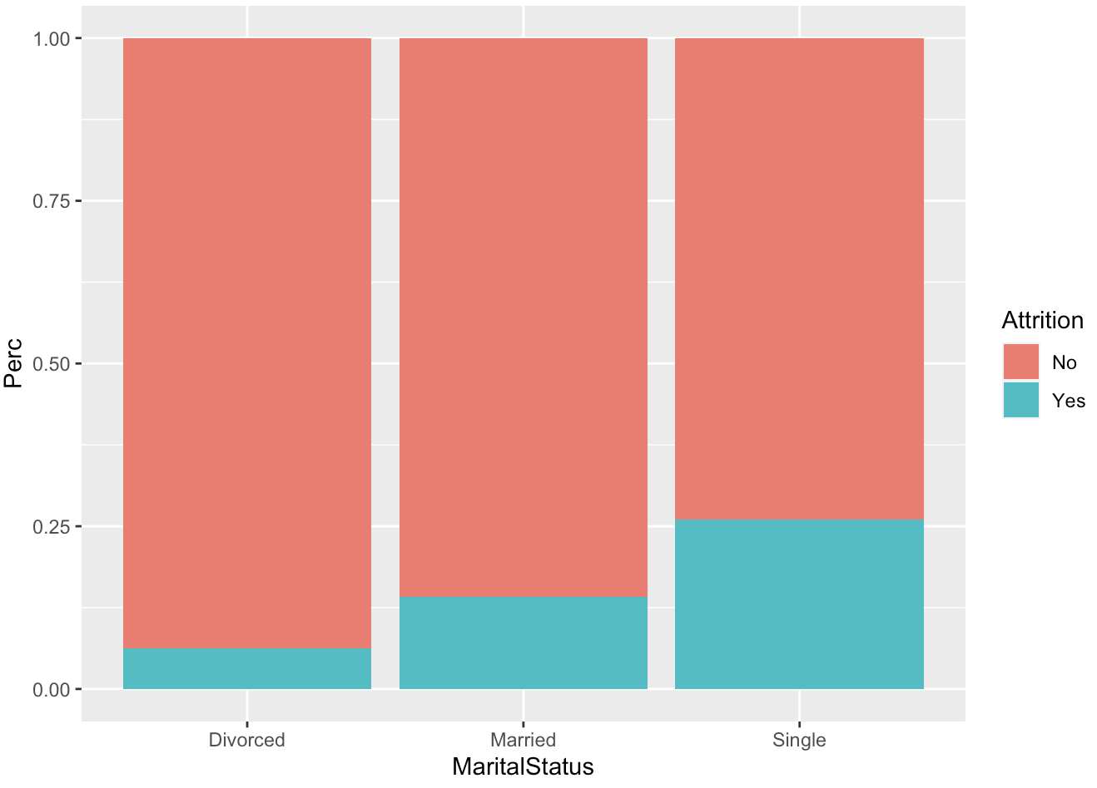
Analysing Important Factors for Employee Attrition Part 4

Slide 6
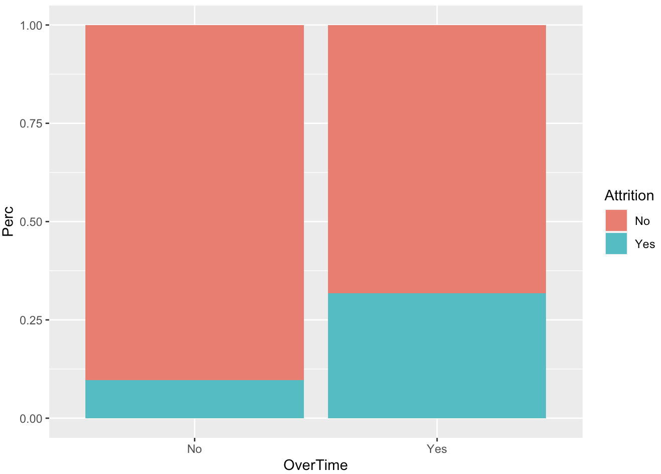
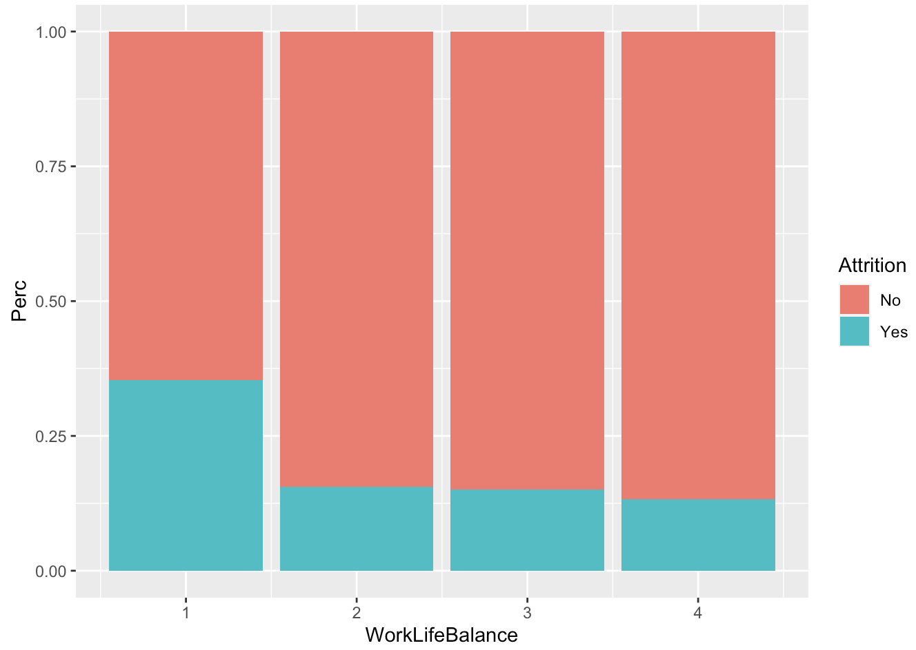
Analysing Important Factors for Employee Attrition Part 5

Slide 7
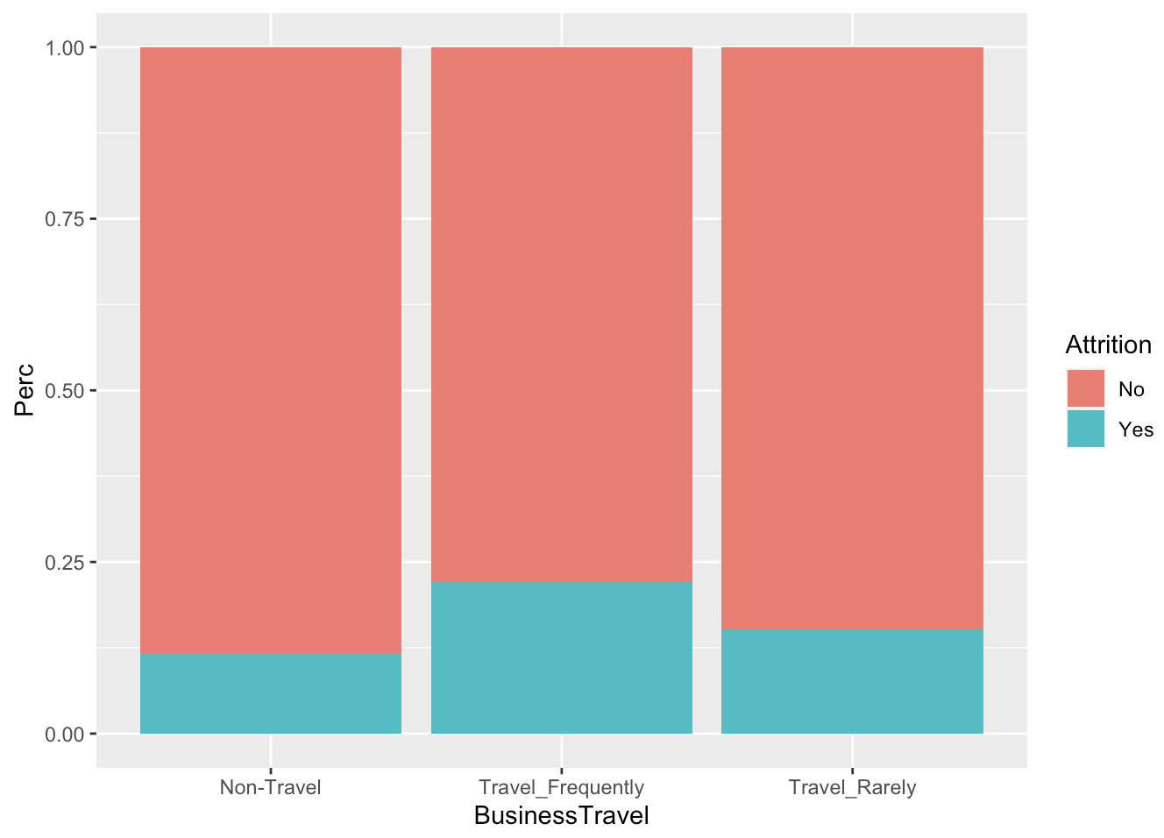
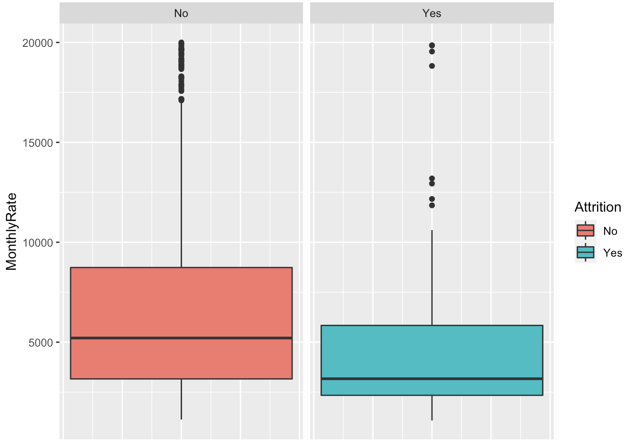
Analysing Important Factors for Employee Attrition Part 6

Slide 8
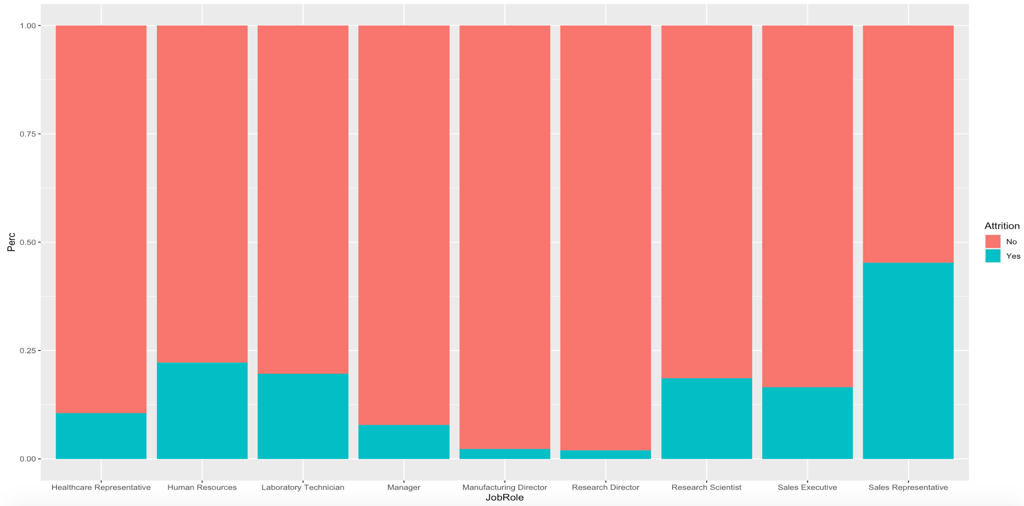
Analysing Important Factors for Employee Attrition Part 7

Slide 9
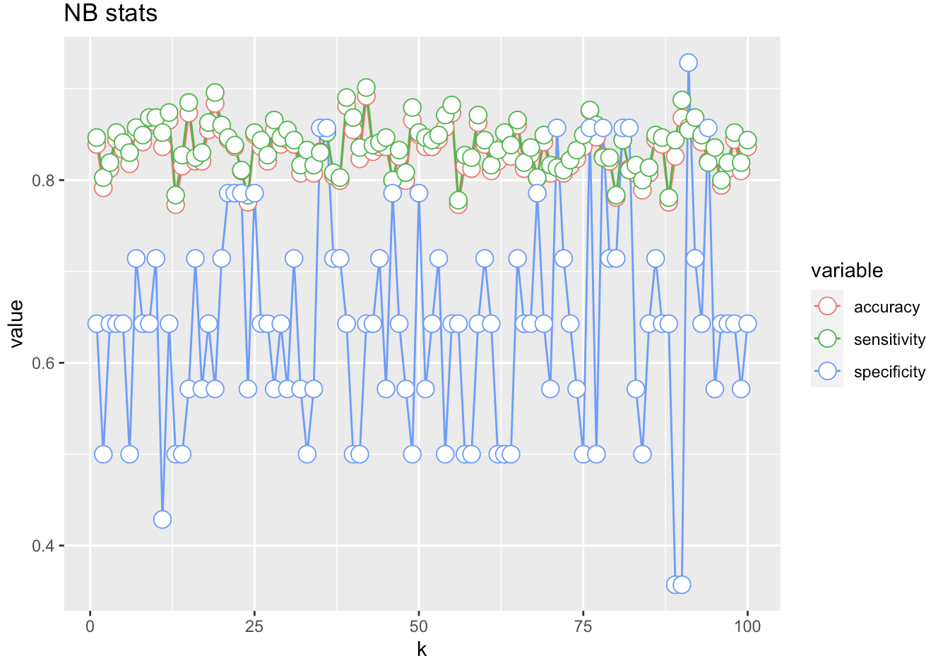
Analysing Important Factors for Employee Attrition Summary
Influential factors in Attrition used in the model:
Age
Distance from Home
Number of Companies worked
Years in Current Role
Monthly Income
Environment Satisfaction
Job Level
Job Role
Job Involvement
Overtime
Marital Status
Work Life Balance
Business Travel
Average Model (NAive Bayes) Prediction Stats:
Accuracy: 83 % Sensitivity: 84 % Specificity: 64 %

Slide 10
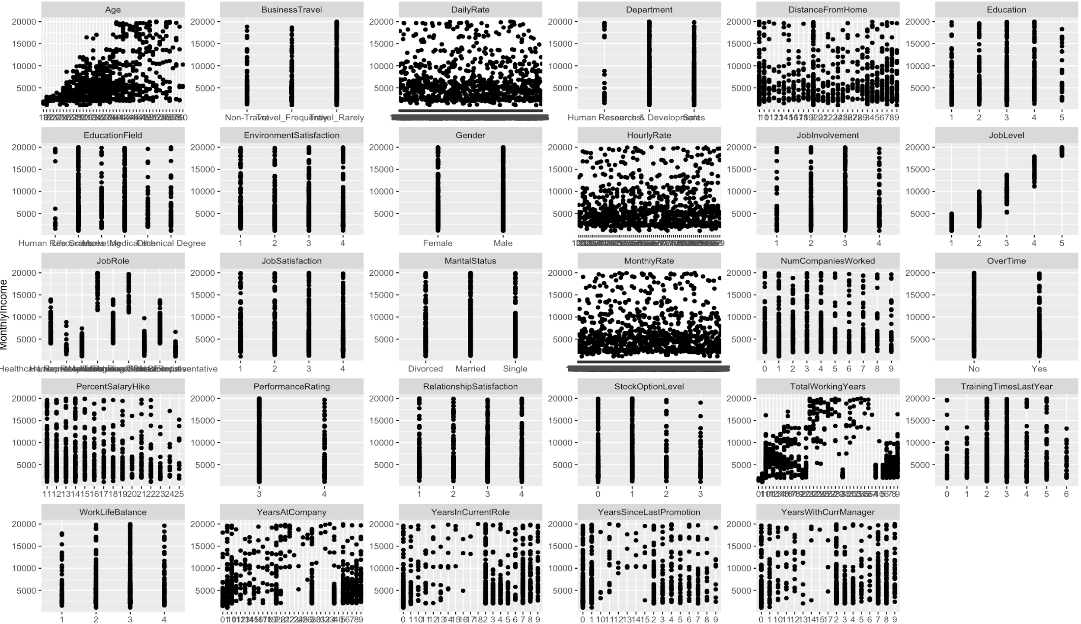
Analysing Important Factors for Salary

Slide 11
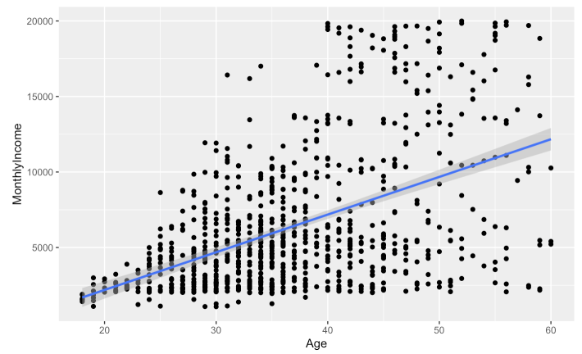
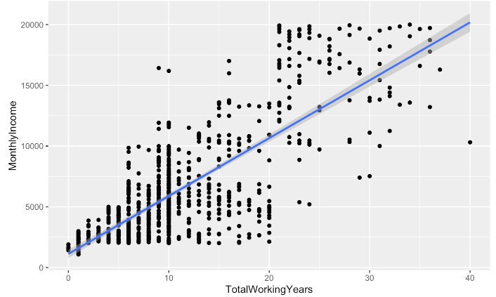
Analysing Important Factors for Salary Part 2

Slide 12
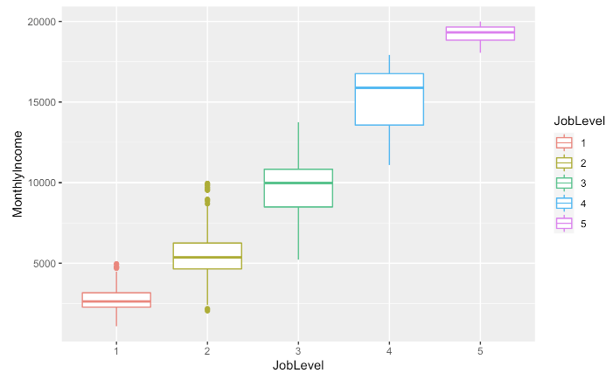
Analysing Important Factors for Salary Part 3

Slide 13
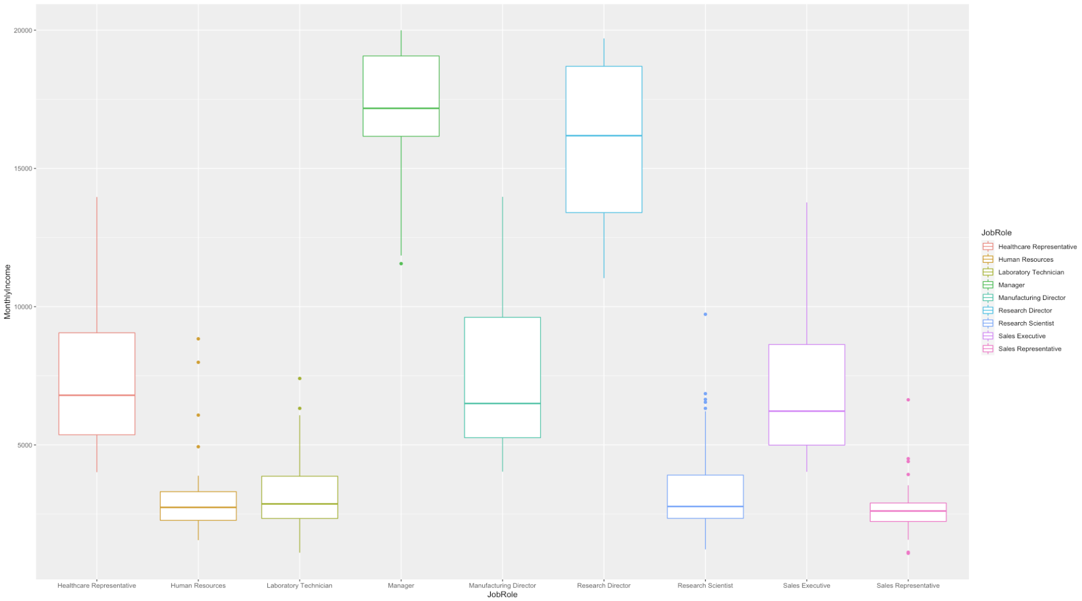
Analysing Important Factors for Salary Part 3

Slide 14
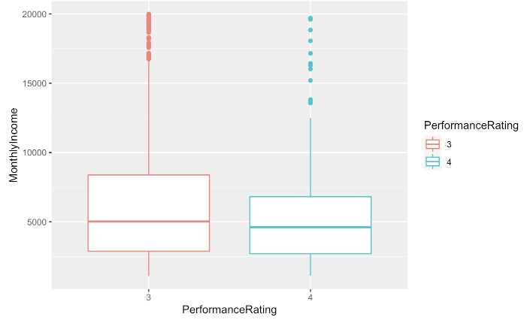
Analysing Important Factors for Salary Part 3

Slide 15
Analysing Important Factors for Salary
Influential factors in Salary Prediction
Age
Number of Companies worked
Job Level
Job Role
Performance Rating
Linear Model Prediction Stats:
Adjusted R-Squared: 94 % RMSE: 1055

Slide 16
Thank You

